Slide 1
Dashboard Incident Management (Incident, Problem & SR Patching)
Summary
Total case (hari ini/bulan ini)
Status case (Open, In Progress, Resolved, Closed)
Prioritas case (Critical, High, Medium, Low)
Kategori case (Transaction/Hardware Issue/QRIS)
Top 5 case berdasarkan kategori
Top 10 case out of SLA
SLA & OLA Monitoring
Informasi case berikut SLA & OLA
List case (open/in-progress/development/UAT/CCB/PTR)
Indikator warna OLA (merah: kritikal, kuning: sedang, hijau: aman)
Timer SLA per case (countdown atau aging)
Progress (%)

Slide 2
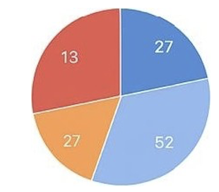
Draft Mockup – Incident Management
Incident Management
INCIDENTS BY SEVERITY
INCIDENTS/PROBLEM/SR PATCHING
125
Total Incidents
54%
SLA COMPLIANCE
46%
OUT OF SLA
• Critical • High
Medium • Low
TOP 5 INCIDENT CATEGOR IES
INCIDENTS BY STATUS
CRITICAL/HIGH INCIDENTS
30
Analysis
56
#Ticket No
Status
Priority
Aging
20
Development
24
15607
In Progress
Critical
6
10
UAT
24
16005
Open
High
17
0
EDC MAAS QRIS Payment Connection
Closed
18
15234
In Progress
High
16
14456
Resolved
High
15

Slide 3
Draft Mockup – Incident Management
Incident Management – Internal/External/Member Bank
INCIDENTS as Of 1 Jan 26 – 30 Apr 26
INCIDENTS BY SEVERITY
125
Total Tickets
100
Resolved Tickets
25
OpenTickets
3
Avg Resol Time (Days)
99%
SLA COMPLIANCE
1%
OUT OF SLA
• Critical • High
Medium • Low
TOP 5 INCIDENT CATEGOR IES
INCIDENTS BY STATUS
INCIDENT REGISTERED Per Month
30
Closed
30
20
Development
20
10
10
0
UAT
0
EDC MAAS QRIS Payment Connection
Jan Feb Mar Apr

Slide 4
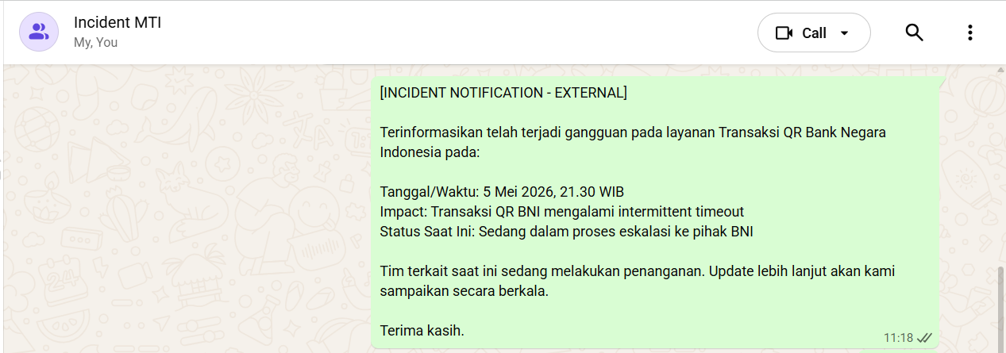
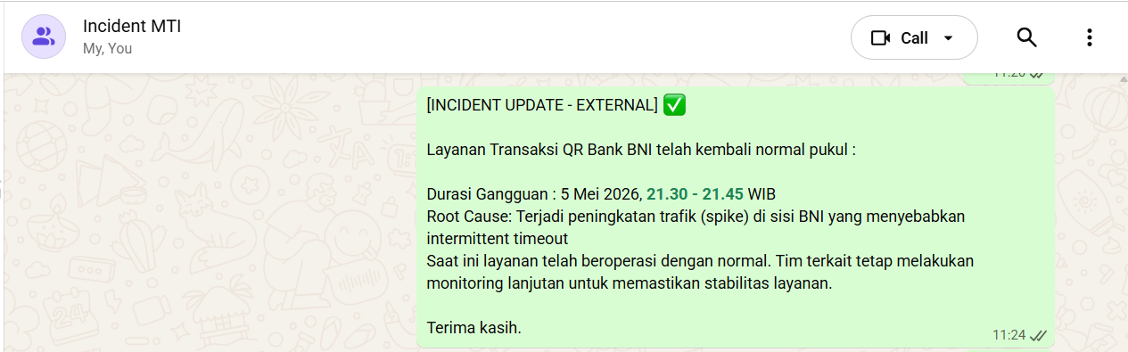
Incident Communication

Slide 5
Draft Mockup – Dashboard Incident Management
Tracker | No Redmine | Description | Priority | Status | SLA | Aging | OLA Incident Management | OLA Application Support | OLA Development | OLA QA | Progress
Incident | 17999 | Kendala transaksi Contacless | Medium | Development | 14 | 7 | Done | Done | In Progress | Not Started | 50%
Incident | 17953 | Perbaikan EDC Android Inhouse | Low | Development | 60 | 50 | Done | Done | In Progress | Not Started | 50%

Slide 6
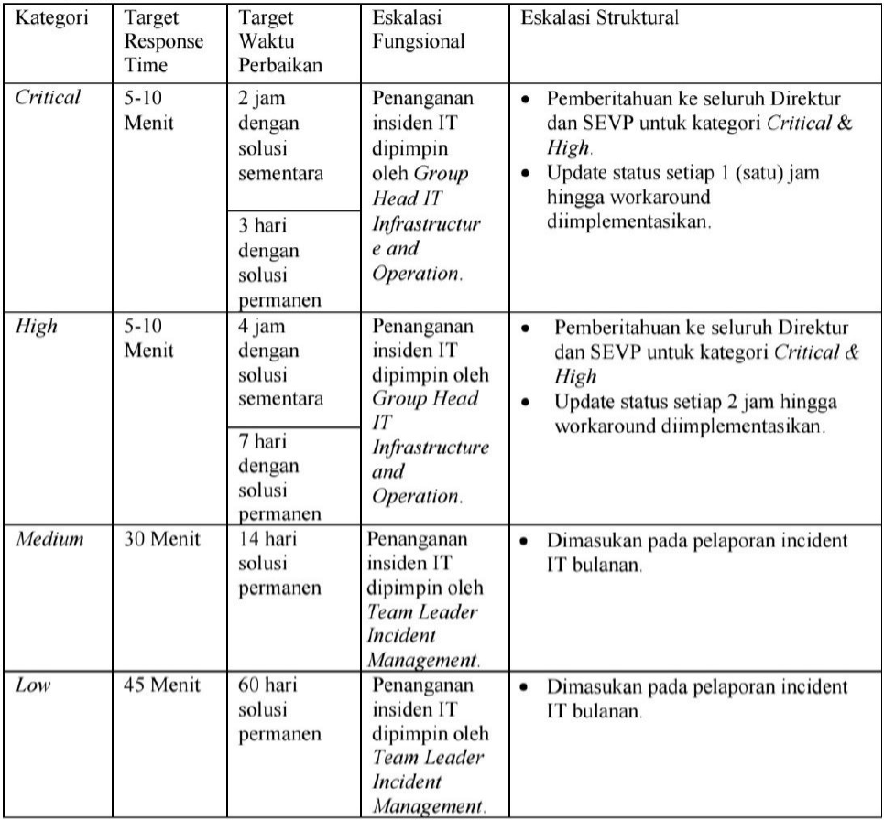
Draft OLA (Operation Level Agreement)
Severity | Temp/ Permanent | SLA Fixing | SLA BAST PTR | OLA
 |  |  |  | IT Helpdesk | Incident Management | IT Application Support | IT Dev | QA
Critical | Temporary | 2 Jam | 7 Hari | 5 Menit | 5 Menit | 110 Menit |  | -
 | Permanent | 3 Hari | 7 Hari | 15 Menit | 20 Menit | - | 2 Hari | 1 Hari
High | Temporary | 4 Jam | 7 Hari | 5 Menit | 15 Menit | 50 Menit | 180 Menit | -
 | Permanent | 7 Hari | 7 Hari | 15 Menit | 20 Menit | - | 4 Hari | 3 Hari
Medium | Permanent | 14 Hari | 7 Hari | 15 Menit | 30 Menit | 1 Hari | 7 Hari | 6 Hari
Low | Permanent | 60 Hari | 7 Hari | 15 Menit | 45 Menit | 3 Hari | 30 Hari | 27 Hari
Notes :
SLA dihitung sejak incident terjadi/tiket dibuat sampai CCB

